Slide 1
Lecture 4 : Instruction Set Architecture
To watch lecture video click link below
Lecture 4a video
To view slides, continue to next slide

Slide 2
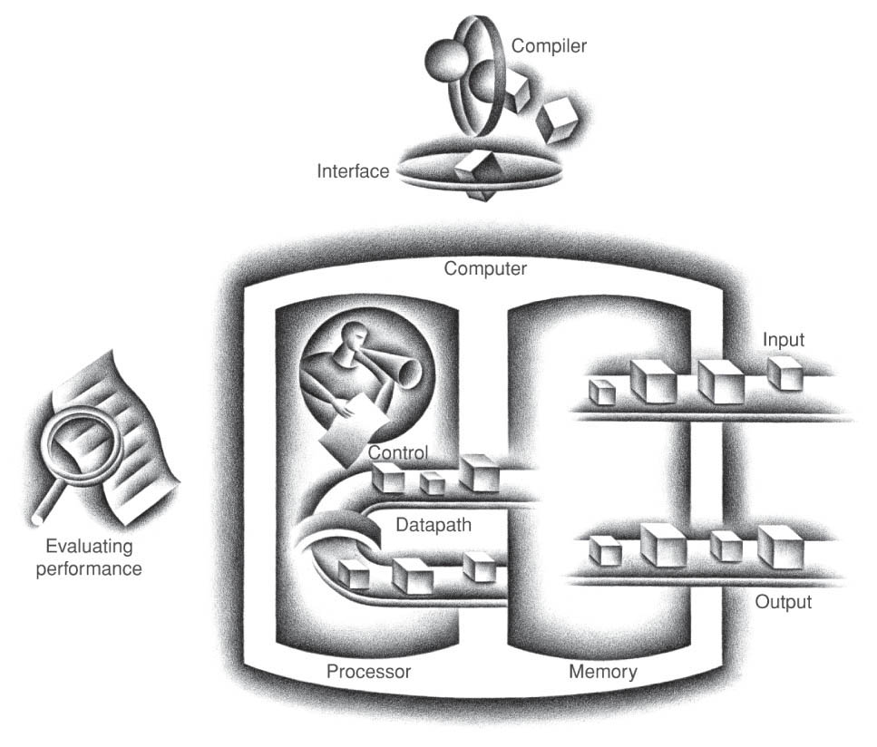
Lecture 4 : Instruction Set Architecture (ISA)

Slide 3
Lecture 4a: Introduction to ISA
Instructions:
Language of the Machine
Figure credit: https://www.computerhope.com/

Slide 4
Instructions
Language of the Machine
Different machines have different instruction sets
I speak Spanish to God, Italian to women, French to men, and German to my horse
Charles V, Holy Roman Emperor, (1500-1558)
CPU
Stored Program Concepts
command
Instruction/data
Memory

Slide 5
Instruction Set Architecture
ISA: SW/HW interface
Application software
Compilers/Interpreters
SW/HW interface

Slide 6
Instruction Set Architecture
An instruction set architecture (ISA) is an abstract model of a computer. A realization of an ISA, such as a central processing unit, is called an implementation. [Wikipedia]
However, the design of ISA is closely related to machine architectural features including but not limited to machine’s basic operations, memory organization, register files, …
Let’s take an look at the Architectural feature first
Many different ISAs available
We will use MIPS ISA as an example

Slide 7
MIPS ISA
MIPS
Microprocessor without Interlocking Pipe Stages (MIPS)
brief history of MIPS (http://www.mips.com/ )
similar to other architectures developed since the 1980's
used by NEC, Nintendo, Silicon Graphics, Sony,…
We’ll be working with the MIPS instruction set architecture
Design goals: maximize performance and minimize cost, reduce design time
Design principle: simple and efficient
MIPS (in performance) : Millions Instructions Per Second
MIPS (in ISA): Microprocessor without Interlocking Pipe Stages
(two complete different acronyms)

Slide 8
MIPS Architectural Features
Registers
32 32-bit general purpose registers (we name as R0, …, R31)
R0 value always 0 (fixed to 0)
32 FP registers (to be discussed later)
Memory
Memory address: 32 bit; memory content: byte addressed.
Load-store & RISC architecture
load–store architecture is an ISA that divides instructions into two categories: memory access (i.e. load and store between memory and registers), and ALU operations (which only use operands stored in registers).
In summary, only load and store instructions can access memory.

Slide 9
Memory Organization
Viewed as a large, single-dimension array
Each memory location has an address.
A memory address is an index into the array
In MIPS, memory is byte-addressed, meaning that the index points to a byte of memory.
Bytes are nice, but most data items use larger "words"
For MIPS, a word is 32 bits or 4 bytes.
Memory size (for direct access in instructions)
32-bit memory address
2³² bytes with byte addresses from 0 to 2³²-1
Or, 2³⁰ words with addresses 0, 4, 8, …
Words are aligned
i.e., what are the least 2 significant bits of a word address?
What is the largest possible memory in MIPS?

Slide 10
1 byte (8 bits)
……
0x00000000
0x00000001
0x00000010
R0
1 word (32 bits)
……
R1
R31
Registers: Illustration
0xFFFFFFFF
Memory: Illustration

Slide 11
Self-Review Questions
Are you able to answer the following questions quickly without Internet search?
What are registers? What hardware commonly used to make registers?
What does the logical view of a memory module look like? What hardware commonly used to make memory modules?
Note: these self-review questions are used to check your background knowledge. You are welcome to share at Piazza discussion.

Slide 12
Memory Size Calculation
Each memory location is 1 byte;
How many memory locations available?
Memory address is 32-bit;
from address 0x00000000 (hex) to 0xFFFFFFFF (hex);
total 2³² locations;
Total Memory = 1 byte * 2³² = 4 * 2³⁰ bytes = 4 GB
GB vs GiB: see next two slides for comparison.
In this class, by default, GB always refer to the binary-base unit, i.e. 1 GB = 2³⁰ bytes

Slide 13
Multiples |  |  | Power of 2 vs. power of 10
unit | Bytes in power of 2 | Bytes in power of 10 | Error rate
kilobyte (KB) | 2¹⁰=1024 | 10³=1000 | 2.3%
megabyte (MB) | 2²⁰ | 10⁶ | 4.6%
gigabyte (GB) | 2³⁰ | 10⁹ | 6.9%
terabyte(TB) | 2⁴⁰ | 10¹² | 9.1%
petabyte(PB) | 2⁵⁰ | 10¹⁵ | 11.2%
exabyte(EB) | 2⁶⁰ | 10¹⁸ | 13.3%
zettabyte(ZB) | 2⁷⁰ | 10²¹
yottabyte(YB) | 2⁸⁰ | 10²⁴
http://greymatter.com
Source: http://en.wikipedia.org/wiki/Byte

Slide 14
Words are aligned
Memory are byte-addressed
each location stores a byte
To store a word
use 4 consecutive bytes
however, not any 4 consecutive bytes
must start with a memory location whose address is a multiple of 4, i.e. last 4 bits of binary address is 00
Examples
address 20 (binary 10100) okay as a starting address for a word
address 19 (binary 10011) not valid as starting address of a word

Slide 15
Basic Issues in Instruction Set Design
Operations of the computer hardware
Fundamental operations
Arithmetic: add, sub, …
Logical: and, or, …
Memory access: load, store,
Branch: branch if equal (beq), branch if not equal (bne), jump …
We will focus on a subset of operations that are commonly supported by all machines
add, sub, and, or, mult, div, load, store, beq, bne, jump

Slide 16
Arithmetic and Logical Instructions
Operations: add, sub, …, and, or, …,
All instructions have 1 destination and 2 operands
Operands must be in registers
Example: C code: A = B + C MIPS code: add R16, R17, R18
Instruction Execution: Content of Register 17 adds with the content of Register 18, the sum is stored in Register 16.
Notes:
MIPS has register conventions (see next slide), however in this class we will use the register numbers directly, i.e. use R16 instead of $s0.
We assume values of variables (such as A, B, i, j, …) are pre-stored in registers, and in examples we randomly pick up some registers to store these values.

Slide 17
Register Conventions
Special note: For convenience, in this class we will name registers directly (e.g. R16 instead of $s0). However, zyBook still uses conventions such as $s0, $t0. There’s no conflicts on using either way, if conversion needed, just use this table as reference.

Slide 18
Data Transfer Instructions
Transfer data between memory and register
Load: from memory to register, Store: from register to memory
lw & sw: load word and store word
Examples
lw R16, 0x0100(R17) sw R16, 0x0100(R17)
Features of load-store architecture (i.e. register-register)
only load and store instructions can access memory, all other instructions (add, sub, and, or, beq, bne, …) must work with data pre-loaded into registers.
This is an important feature from most of RISC architecture (RISC architecture will be discussed later in this Module.)

Slide 19
lw & sw: Example
Example: C code: A[8] = h + A[8]; //assume all integers MIPS code: lw R8, 0x0020(R18) add R8, R17, R8 sw R8, 0x0020(R18)
Assume R18 contains A’s starting address, R17 contains the value h
0x0020 is 32₁₀ an offset between A[8] and A[0], because 4 bytes each word, A[8] is 8 words (32 bytes) away from A[0].
Thus, to calculate A[8] address: Reg[R18] + signExt (0x0020)
(sign extension is needed to align both operands of addition to 32-bit.)

Slide 20
Decision Making Instructions
Branch
alter the control flow,
i.e., change the "next" instruction to be executed
MIPS conditional branch instructions: bne R8, R9, Label beq R8, R9, Label
Example: if (i !=j) h = i + j; beq R16, R17, Label add R18, R16, R17 Label: ....

Slide 21
Execution of Beq
Assume the following sequence of instructions are stored in the memory starting from address 0xFFFF0004, currently we’re executing the beq instruction, thus PC <- 0xFFFF0004 (note: PC is the program counter).
Each instruction is 32-bit, so it takes 4 types to store it. (remember, memory is byte-addressed)
…
beq R16, R17, Label
add R18, R16, R17
Label:
…
0xFFFF0004
0xFFFF0008
0xFFFF000C
To execute the beq instruction, compare R16’s content with that of R17 first, if equal, PC counter will be reset to 0xFFFF000C, actually PC will be added to an offset (between beq and Label). The offset will be calculated by the assembler so in this class later we will directly put the offset instead a Label in the instruction.

Slide 22
Unconditional Branch Instructions
j address or j label (jump)
jal address or jal label (jump and link)
jr Regsiter (jump register)
Example:
if (i!=j) beq R16, R17, Lab1 h=i+j; add R18, R16, R17 else j Lab2 h=i-j; Lab1: sub R18, R16, R17 Lab2: ...
Note: we will not further discuss unconditional branch instructions in this class.

Slide 23
Constants
Small constants are used frequently (50% of operands) e.g., A = A + 5; B = B and 1; C = C - 18;
Some sample MIPS Instructions: addi R16, R16, 5 andi R17, R17, 1 addi R18, R18, -18
Note: no subi instruction needed
C = C – 18 is equivalent to C=C+(-18)
Note: addi and add are two different instructions.

Slide 24
Summary
MIPS Instruction Set Architecture
Machine Organization
Register file
# of registers, size of each register, …
Memory Organization
memory address, memory capacity, byte/word addressed, …
MIPS instructions
A small subset of MIPS
Know the operations and operands of these instructions.
Get basic idea of the execution of these instructions.

Slide 25
Summary (cont.)
zyBook 2.1-2.3
Thinking Questions (encourage discussions among teams, not for credit)
What is the largest possible memory size we can use in a MIPS CPU?
hint: we need to give every memory location an address.
Now, how many distinct addresses available? (i.e. how many bits for memory address? )
If your ISA background is not MIPS, what’re the key differences between MIPS and the ISA you learned previously?

